Slide 1
BATTERY THERMAL MANAGEMENT USING HEAT PIPE AND PELTIER COOLING INTEGRATED SYSTEM

Slide 2
Problem statement
Thermal management remains a significant challenge due to the dynamic nature of battery behavior and the varying environmental conditions.
These challenges include temperature control, heat dissipation, and battery health monitoring.
there is a need for a comprehensive thermal management system that can optimize the performance of the battery.
The system must be capable of regulating the temperature of Li-ion batteries within an optimal range to prevent overheating, thermal runaway.
The system should be scalable, adaptable, and flexible enough to accommodate various battery chemistries, sizes, and configurations in different applications and environments.

Slide 3
Need of your Project
Battery thermal management systems are needed to ensure optimal performance and safety of batteries, especially in electric vehicles.
The temperature of the batteries to prevent damage and improve efficiency
battery thermal management systems play a critical role in maximizing the performance, safety, and lifespan of batteries, particularly in high-demand applications like electric vehicles.
Now a days most of the electric vehicles were got fire because of the battery heating.So,by using an efficient method to solve this problem.

Slide 4
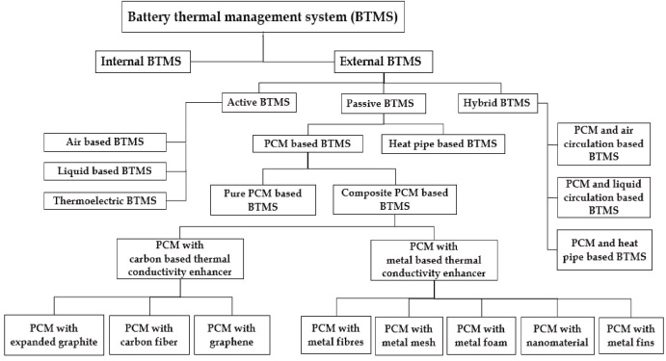

Slide 5




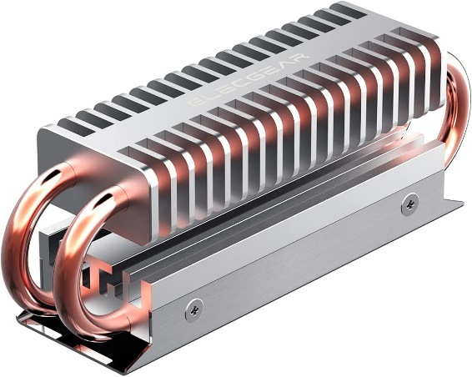
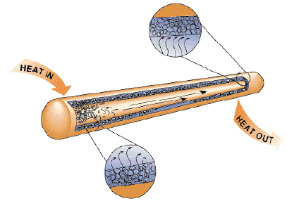
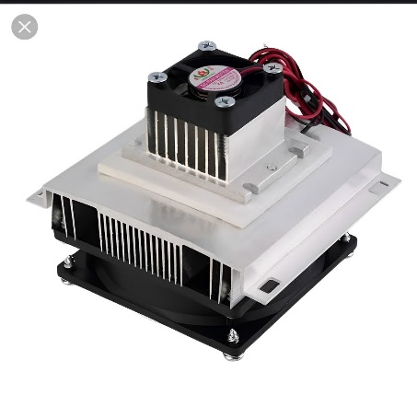

Innovation solution for the problem statement
Heat Removed From Battery Pack
Cell
Heat
Control Module
Temperature Sensor
Heat From the Cell
Result
Heat Pipe Integrated System
Heat Pipe
Peltier cooling system

Slide 6
Output from the journal reference like literature review.
http://www.elsevier.com/locate/jpowsour
http://www.sciencedirect.com/journal/international-journal-of-thermofluids
http://www.elsevier.com/locate/enconman
http://www.elsevier.com/locate/energy
http://www.mdpi.com/journal/energies
http://www.elsevier.com/locate/matpr
http://www.elsevier.com/locate/est
http://www.elsevier.com/locate/ijts
http://www.elsevier.com/locate/enconman

Slide 7
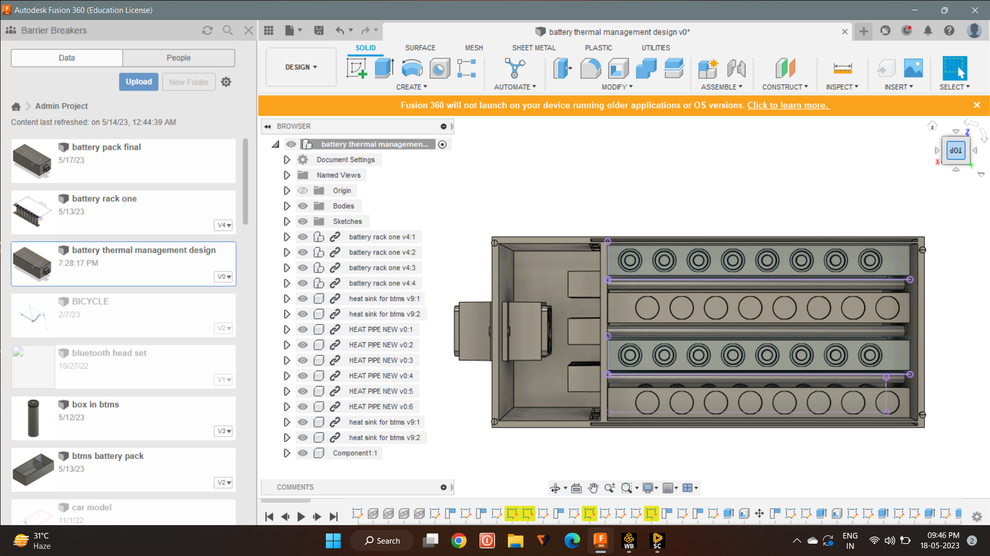
Tentative design of your solution both 2d and 3d
Peltier cooling system
Fan
Heat sink
li-ion cell
Cell rack
Heat pipe

Slide 8
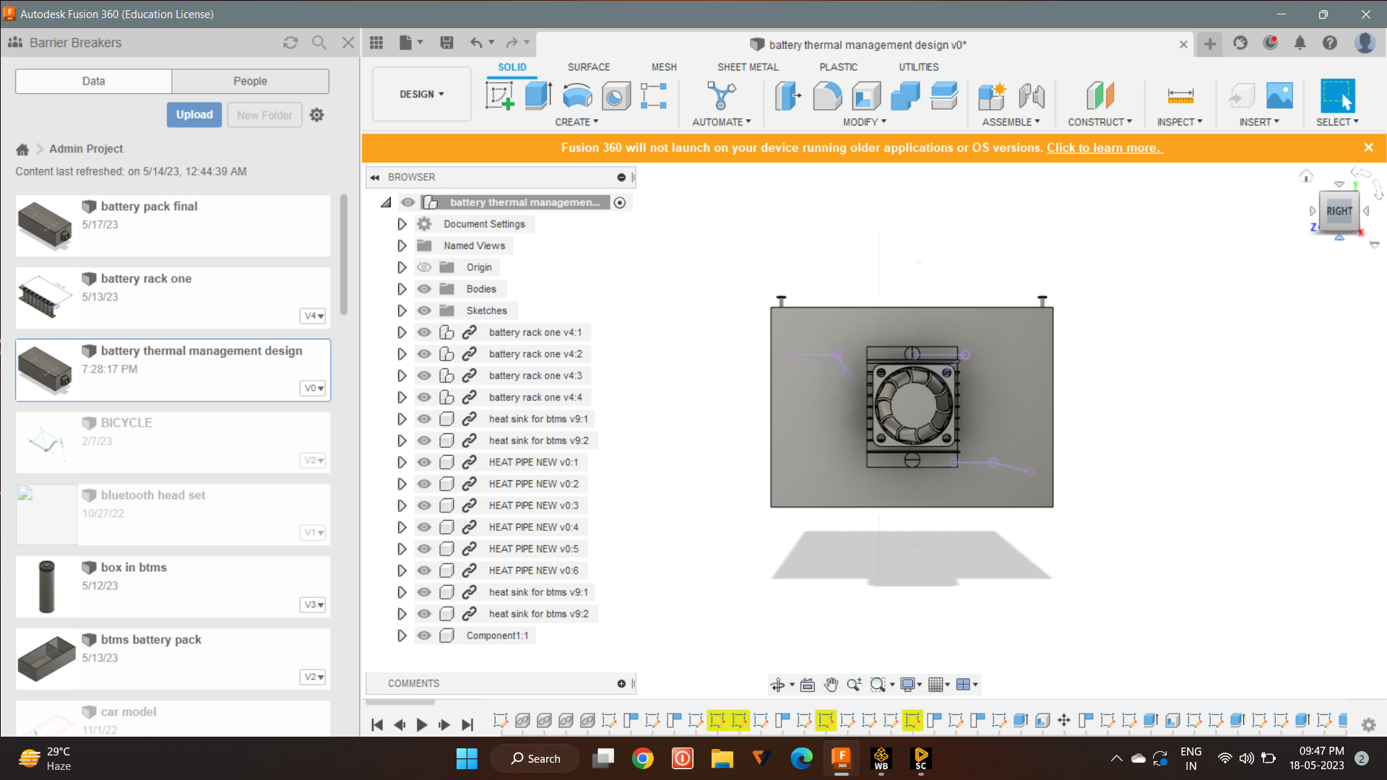
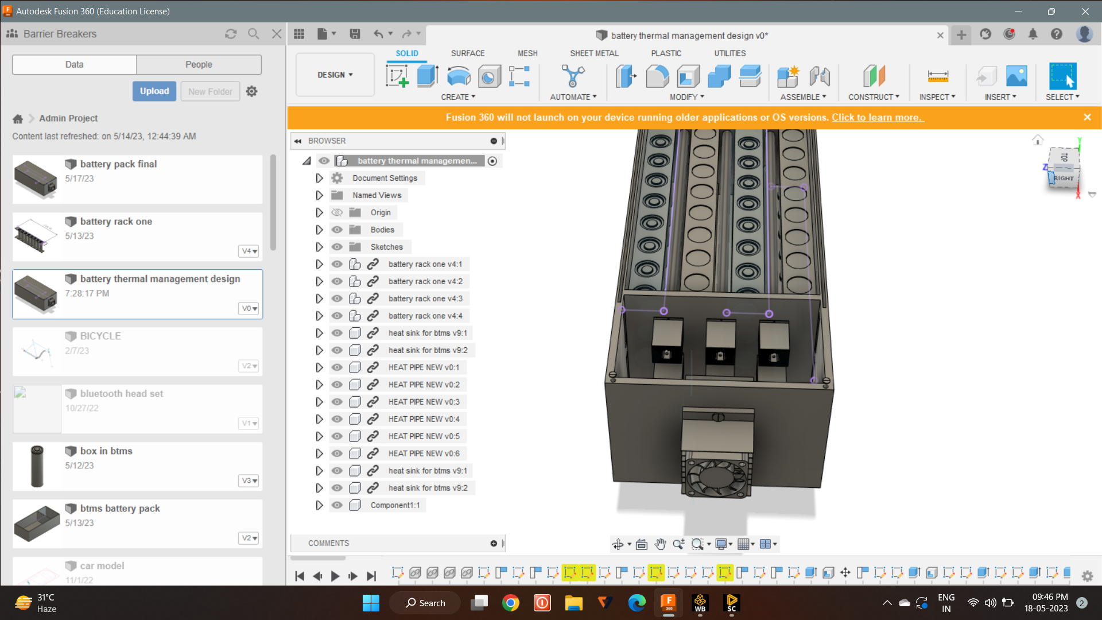
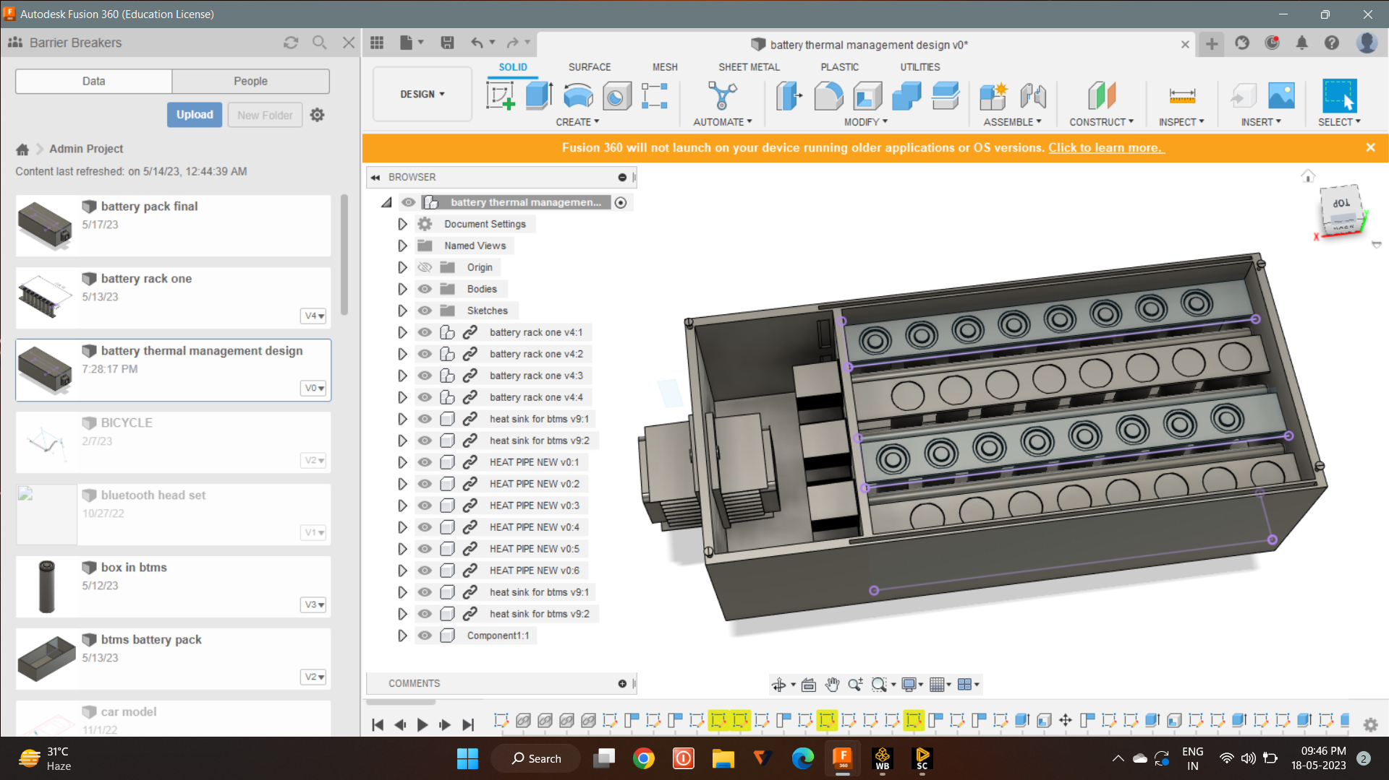
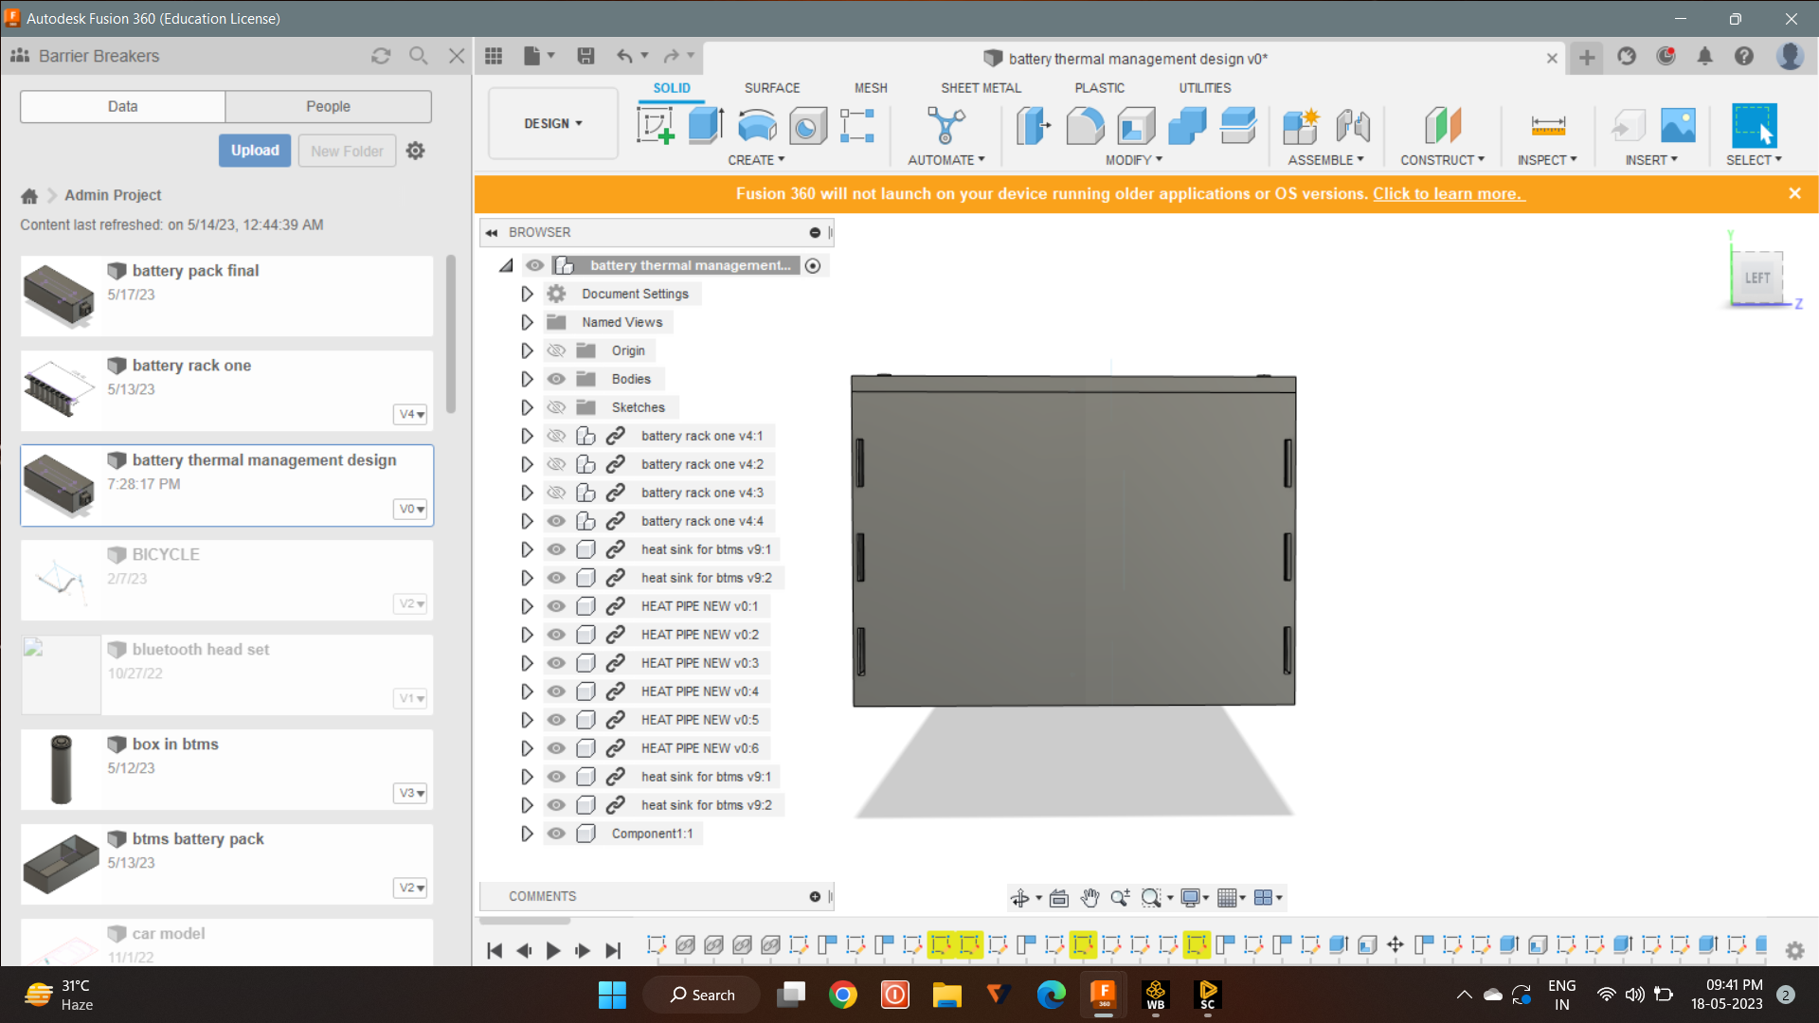
Different Views of our CADD model

Slide 9
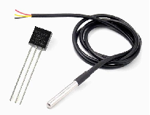
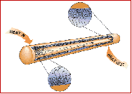

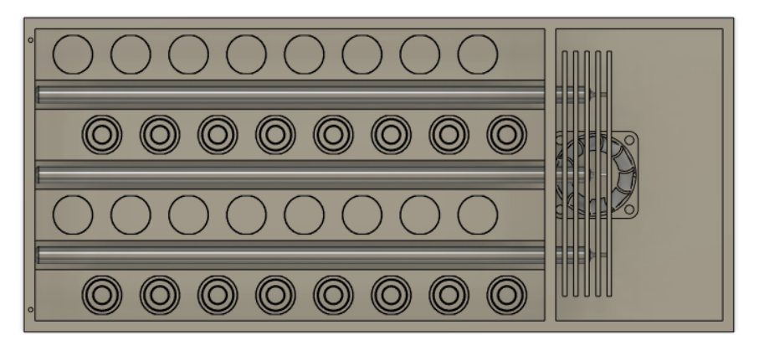
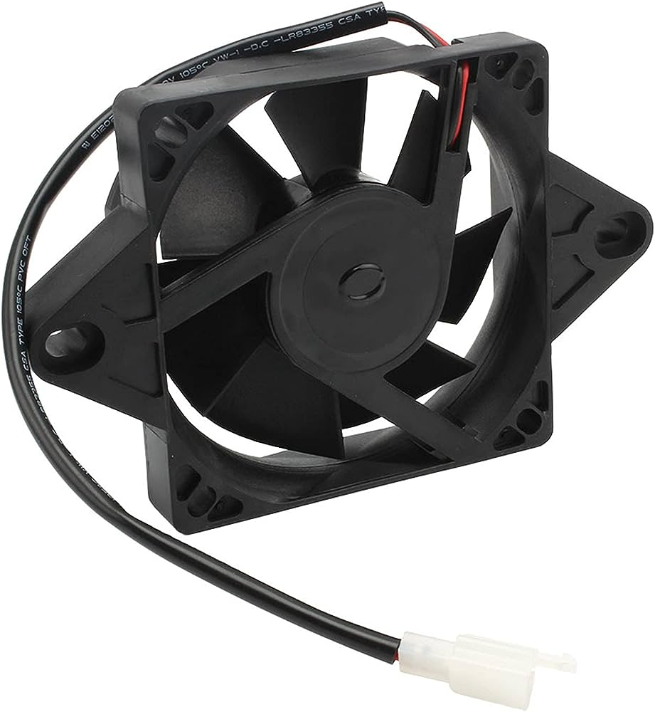
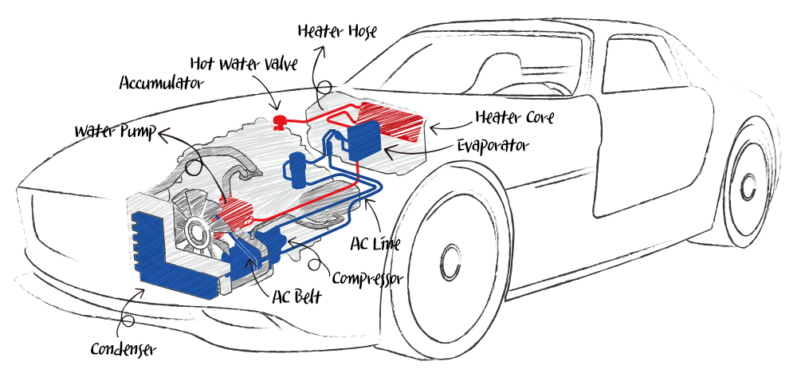
Basic Overview
Heat pipe
sensor
Module
Battery setup
fan
Car AC setup

Slide 10
Justification based on the theoretical data
BMS for utilizing multiple types of lithium batteries to develop battery packs
https://tracxn.com/d/companies/brill-power/__MxmDBxxvG3gPAxfdy31hA7SUqOxWFfB-PvbI7QNbbCM
Provider of energy management solutions for commercial and industrial solutions
https://tracxn.com/d/companies/verlume/__zrQZjuZlPWRibApTw8FyNdVg39Vvu0PGXmaQi47OMQI
Designs smart energy storage systems
https://tracxn.com/d/companies/dukosi/__I56ODJghF7tpfZt6XMjOGXGuQkHe61sCLmaelcd2ENk
Developer of safety technology for lithium-based batteries
https://tracxn.com/d/companies/amionx/__0ehDjDyhQrZy026o079o99YTVO3PgMPVlQrKEimYxcg

Slide 11
Action plan
Evaluating the weight of the graphite in the previous plan and we replace the graphite into MIVOLT dielectric liquid.
To create a design in the battery pack, peltier cooling system, cooling fan and so on.
To see the how much heat is produced in the lithium ion cell and how much efficiency that our product achieved compared to others.
To work on the connections of the li-ion battery.
Selection of battery pack material.

Slide 12
Expected output or output obtained in the past research work or techniques followed in industry for BTMS
In that stage of BTMS, the design is completed and we shall proceed in the ANSYS software to analyze our design
Past research works have focused on the choosing liquid is to make cool the cells.
In industry, advanced thermal management systems are used in electric vehicles and other applications to maintain battery temperature and reduce the risk of thermal incidents.

Slide 13

Targeted work completion
First, selecting a liquid coolant capable of absorbing and dissipating heat from the battery cells. Additionally, a heat pipe would be required to transfer the heat from the liquid coolant to the ambient air or a separate cooling system.
Finalizing the coolant medium used for battery immersed cooling and choose the material of the battery pack for our battery.
Fixing the dimension of the heat pipe and other components based on our application.
Finally, sensors and controls would be needed to monitor the temperature of the battery cells and adjust the flow of coolant as needed to maintain optimal operating temperatures.

Slide 14
Startups in our area
1. Chroma ATE Inc.: A startup that provides battery simulation and testing services, including thermal management systems for batteries. Los Angeles, California
2. 24M Technologies: A startup that develops low-cost, high-performance lithium-ion batteries with advanced thermal management systems. Cambridge U.S
3. MAHLE GmbH: A German-based startup that provides innovative thermal management solutions for electric vehicle batteries. Stuttgart, Germany
4. Nuvation Energy: A startup that offers advanced battery management systems with thermal management capabilities for energy storage applications. Sunnyvale, United States
5. Viridity Energy Solutions: A startup that specializes in grid-scale energy storage systems with advanced thermal management for batteries. Oregon, US

Slide 15
6. Cadenza Innovation: A startup that provides lithium-ion battery systems with proprietary thermal management technology for various applications. Danbury, Connecticut
8. Enevate Corporation: A startup that develops advanced energy storage systems with fast charging capabilities and thermal management technology. Irvine, California, USA
9. Eberspächer: A German-based startup that provides heating and cooling solutions for battery thermal management systems in electric vehicles.
10. Pyrotek: A startup that offers innovative thermal management solutions for energy storage systems, including battery management for electric vehicles.

